Slide 1

Web Development Nanodegree
Session four
Conducted by: Hamza
Notes:
V imp links
Intro to Backend - Udacity: https://classroom.udacity.com/courses/ud171
Deploying Web Applications with Heroku - Udacity: https://classroom.udacity.com/courses/ud272
Writing READMEs - Udacity: https://classroom.udacity.com/courses/ud777
Networking for Web Developers - Udacity: https://classroom.udacity.com/courses/ud256/lessons/7090748708/concepts/70675111450923
HTTP & Web Servers - Udacity: https://classroom.udacity.com/courses/ud303/lessons/6ff26dd7-51d6-49b3-9f90-41377bff4564/concepts/ab2f6d8d-fef4-4997-9768-e6e73325b9cb
Google Maps APIs - Udacity: https://classroom.udacity.com/courses/ud864/lessons/8304370457/concepts/83061122970923
Client-Server Communication - Udacity: https://classroom.udacity.com/courses/ud897/lessons/8162118632/concepts/81893830650923
Front End Frameworks - Udacity: https://classroom.udacity.com/courses/ud894/lessons/7084452321/concepts/70929589470923

Slide 2
Agenda
APIs
Configuration
Import
WTFORMS
Breakout

Slide 3

API
Notes:
Matba5 el sheeef sherbeeny
Lw sabny msh ha3rf awsal lel ma2adeer , msh ha3rf a3mel el tab5a
Mmken asra2 7agat
Mmken asra2 ser el 5alta
F 3shan keda beygebly el garsoon
Uniform interface :
Walk through
Normal customer
Delivery

Slide 4
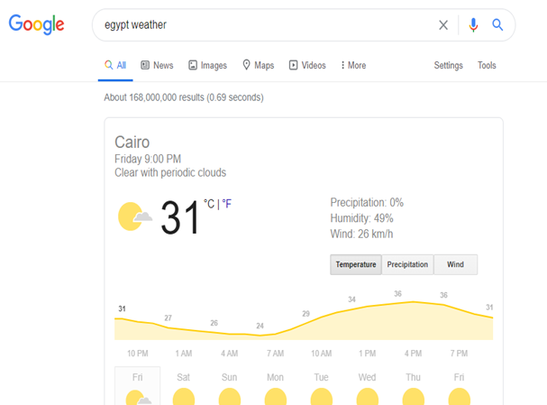
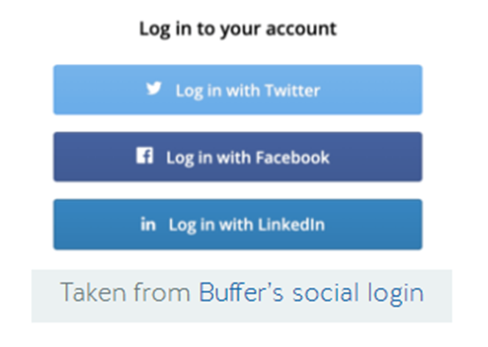
API examples
Notes:
Instead of actually logging-in to users’ social media accounts (which would pose a serious security concern), applications with this functionality leverage these platforms’ APIs to authenticate the user with each login
Every time the application loads, it uses the API to check whether the user is already logged in by means of whatever social media platform. If not, when the user clicks the “Log-in Using XYZ” button, a pop-up opens where they are asked to confirm they actually want to log-in with that social media profile. When the user confirms, the API provides the application with identification information, so it knows who’s logging in.
https://nordicapis.com/5-examples-of-apis-we-use-in-our-everyday-lives/

Slide 5
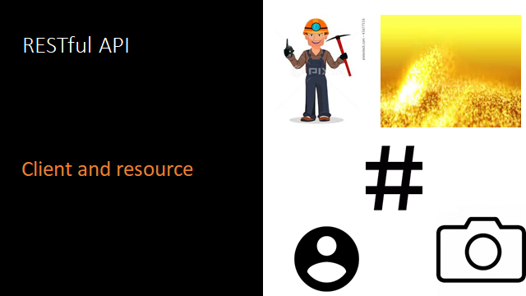
Notes:
A resource is the fundamental concept in the world of REST architecture. A resource is an object with a type, associated data, and relationships to other resources alongside a set of methods that can be executed on it.
REST is not a standard or protocol; it is more like a software architectural style. Many engineers follow this architectural style to build their applications, such as eBay, Facebook, and Google Maps. These web applications serve huge amounts of traffic every second, so you can see that REST really is a scalable architecture style. And when we say RESTful API, we are referring to an API that conforms to the REST constraints/principles.

Slide 6
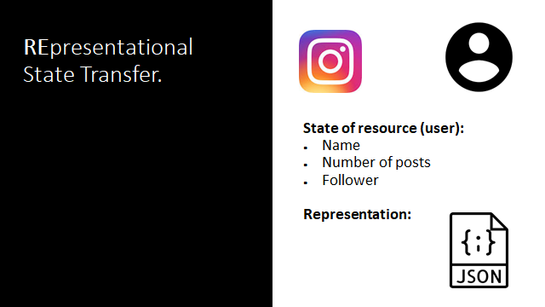
Notes:
URL vs URI URI could be the name
Resource ?? Remember URI
Uniform resource
https://webmasters.stackexchange.com/questions/19101/what-is-the-difference-between-a-uri-and-a-url
https://stackoverflow.com/questions/176264/what-is-the-difference-between-a-uri-a-url-and-a-urn

Slide 7
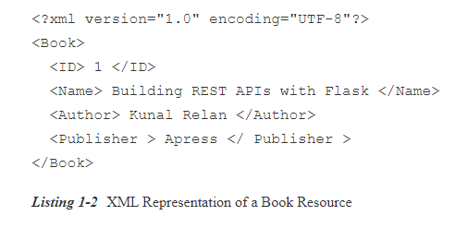
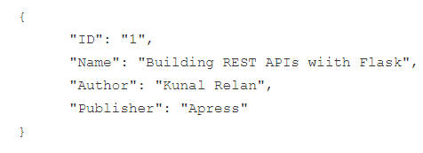
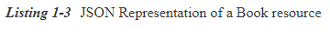

Slide 8





RESTful APIs
A piece
Uniform interface
Representational State Transfer
Notes:
We can even use marshmallow to decide which info about a resource should be shared with the client
Facebook knows u more than ur mother, just from likes
Uniform Interface: Every rest architecture must have a standardized way of accessing and processing data resources. This include unique resource identifiers (i.e., unique URLs) and self-descriptive messages in the server response that describe how to process the representation (for instance JSON vs XML) of the data resource.
Google Maps sending out a whole item example - Getting piece of data (resource) when you click a ENDPOINT EXAMPLE: https://api.github.com/users/omargaber
An API is also a standard interface that can communicate with different types of frontend Terminals, they can be mobile applications or websites. As long as the frontend is sending the same request to the API, it will get the same result back. If we go back to our metaphor, the waiter/waitress will serve all kinds of customers, regardless of their gender, age, language, and so on.
Open API is a third-party API that is open to use. There are plenty of them available out there. Companies are eager to open their APIs to expand their user base but at the same time keep their source code proprietary.

Slide 9
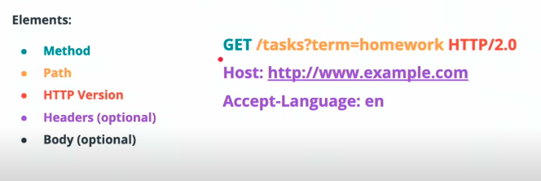
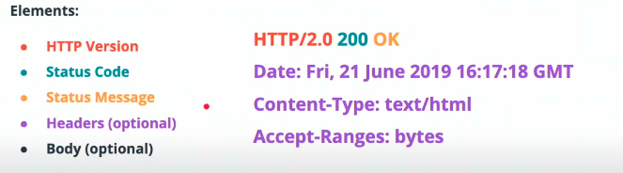
HTTP Requests and Responses
Requests
Responses
https://developer.mozilla.org/en-US/docs/Web/HTTP/Status
Notes:
Sessions through caching for token passing for example
GET - POST - PUT - PATCH - DELETE
OPTIONS -> Sends communication options for requested resource. Usually its automatically handled
Who would have a body and who wouldn’t ?

Slide 10





HTTP is:
Stateless
NOT Sessionless
Must vs can
Notes:
Caching — just means that you’re storing the results to a common request somewhere. This makes it faster and less expensive (compute, networking costs) to serve/send content to whomever is requesting it.
Fool w ta3meya,, hwa 3ando asnaf Tanya .. Bas 3aref en el ta3melya el talab 3leeha keteer, w beta5od 2aleya keteer .. Haygahezha (caching el response) bas haytala3ha lama el boon yegeelo ,, el boon lazem yeb2a kamel w msh mo3tamed 3la el 2ablo
using headers, cookies and caching u create sessions
these sessions allow us to navigate through facebook account messages and blogs. Also this is important for efficiency
Which feature of HTTP solves for the following problem?
The client makes a request and opens a connection over port 3000 to the server. When they receive the response, that port doesn't close. When a new request is sent, it fails because the port is occupied. Ans: connectionless
the server does not remember anything about the user who uses the API
It doesn’t remember if the user of the API already sent a GET request for the same resource in the past, it doesn’t remember which resources the user of the API requested before, and so on.
Each individual request contains all the information the server needs to perform the request and return a response, regardless of other requests made by the same API user.
If google maps stored information about every user request… what would happen to the server?
Also if requests depend on each other, the probability of error would be much higher.
Advantages of Statelessness
There are some very noticeable advantages for having REST APIs stateless.
Statelessness helps in scaling the APIs to millions of concurrent users by deploying it to multiple servers. Any server can handle any request because there is no session related dependency.
Being stateless makes REST APIs less complex – by removing all server-side state synchronization logic.
A stateless API is also easy to cache as well. Specific software can decide whether or not to cache the result of an HTTP request just by looking at that one request. There’s no nagging uncertainty that state from a previous request might affect the cacheability of this one. It improves the performance of applications.
The server never loses track of “where” each client is in the application because the client sends all necessary information with each request.
It is much easier to debug when u focus on a single request
https://restfulapi.net/statelessness/
https://aws.amazon.com/caching/

Slide 11
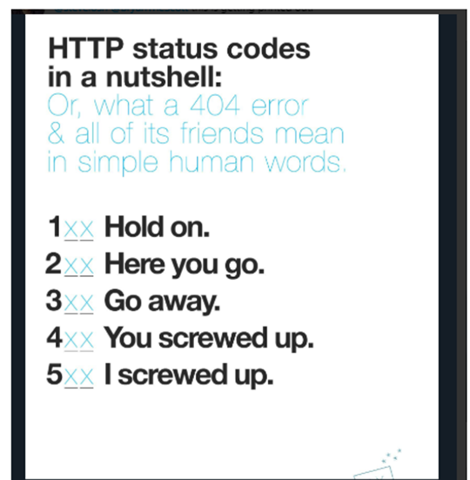
HTTP requests
Notes:
100 happens in OPTIONS request using CORS.. It means طريقك أخضر
What are the non simple requests (not like GET and POST)

Slide 12



Slide 13

https://httpstatusdogs.com/
When can we encounter this?
Notes:
When can u see this? If u didn’t specify a POST for example and u are trying to create
What is the default ? GET

Slide 14
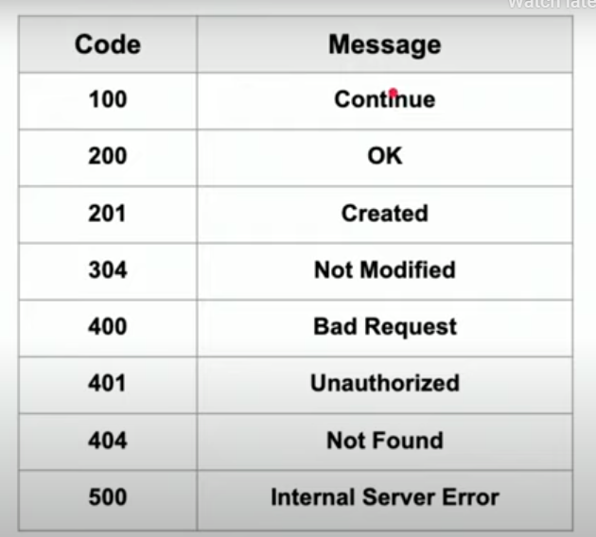
Errors
Notes:
201: with which method ?
304 : when a put or patch was not successful

Slide 15



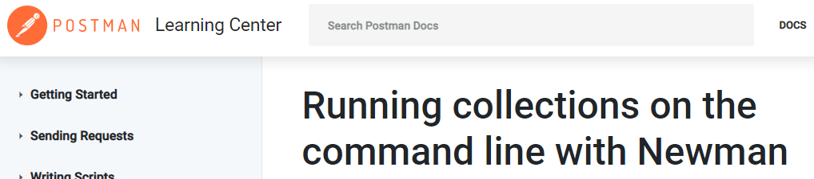
Testing
Notes:
In postman, u can use the button bootcamp to know more about postman via tutorials
Also u can save requests for later use
U can also automate testing by running collection
https://stackabuse.com/using-curl-in-python-with-pycurl/ pycurl instead of curl

Slide 16
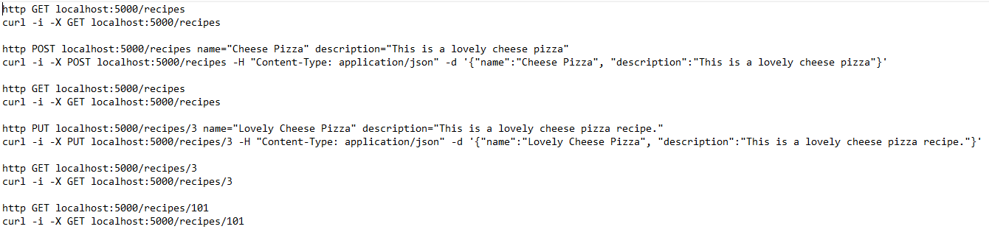
Curl vs httpie

Slide 17
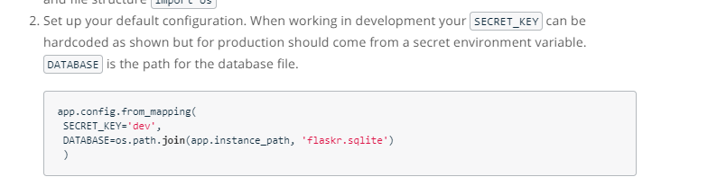
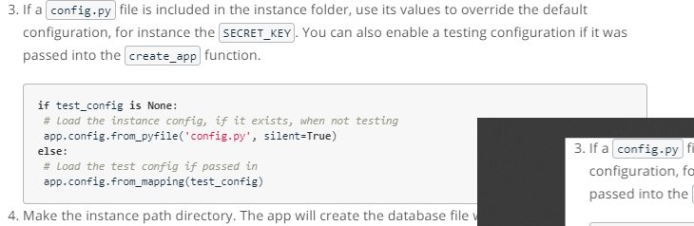
Notes:
What’s this ?
This is in intro to flask lesson

Slide 18


Configuration
Notes:
Very easy flask set up
No time to focus on configuration
Msh 3yzeen l sandwich yebozz
https://hackersandslackers.com/configure-flask-applications
Config variables belong in config files for a reason. They're an organized set of instructions that are defined before our app is live. Moreover, it's much easier to avoid compromising sensitive secrets such as AWS or database credentials when we manage these things in one place.

Slide 19
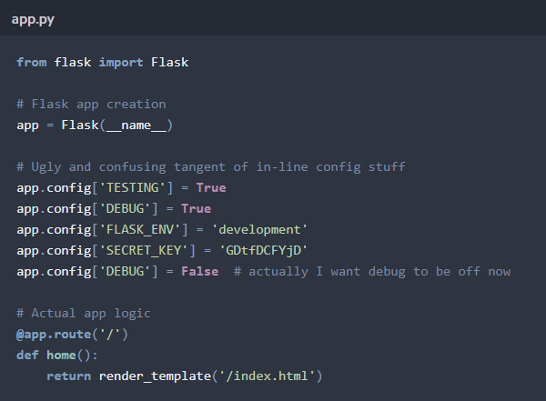
What is the problem?
Notes:
Readable ? Organized ?
Secret key ?
Create and mutate config while app is running ? What is the problem?

Slide 20
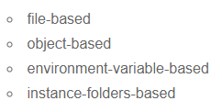
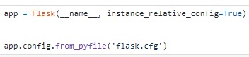
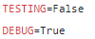
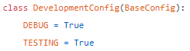
Different alternatives
Notes:
Will consider different alternatives because app are written in different ways and we want to understand apps when we encounter them
Moving from up to down
1st object
2nd file
3rd instance folder
4th file
5th object

Slide 21
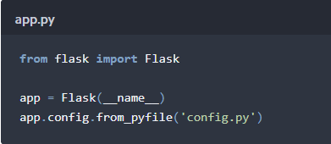
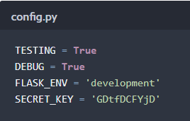
Configuration from a .py File
Which problem is still not solved ?
Notes:
Exposing secret key

Slide 22
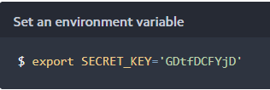
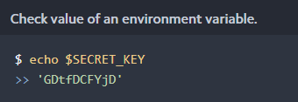
Environment variables
Any drawbacks?
Notes:
An "environment variable" is a value stored in the system memory of the device running your app. Environment variables can be temporarily created via the terminal like so:
SECRET_KEY will exist as long as you keep your terminal open. You can retrieve variables like these on your local machine like so:

Slide 23
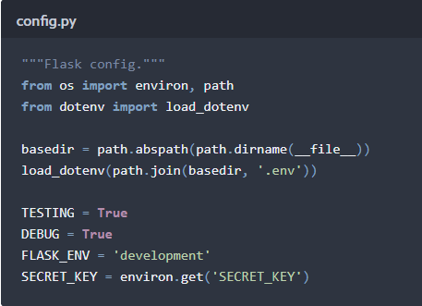
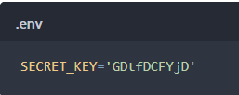
Solution
Notes:
https://stackoverflow.com/questions/38412495/difference-between-os-path-dirnameos-path-abspath-file-and-os-path-dirnam
It would be annoying to set these variables every time we open our terminal, so we can set environment variables in a local file called .env instead and grab those variables using a Python library like python-dotenv:
os.path.dirname() function simply removes the last segment of a path.
__file__ is the pathname of the file from which the module was loaded, if it was loaded from a file.
However, it can be a relative path, so the os.path.abspath() function is used to turn that into an absolute path before removing just the filename and storing the full path to the directory the module lives in in PROJECT_ROOT

Slide 24
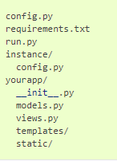
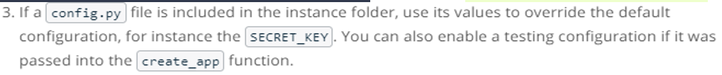
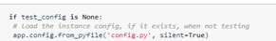
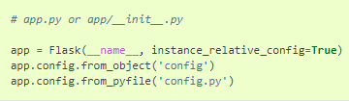
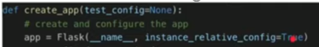
Instance folder
Notes:
Now, we can define variables in instance/config.py just like you did in config.py. You should also add the instance folder to your version control system’s ignore list. To do this with Git, you would add instance/ on a new line in .gitignore.
Configuration — Explore Flask 1.0 documentation: https://exploreflask.com/en/latest/configuration.html#the-simple-case
What is from mapping ..
IDK ☹
Instance relative config means there is a config file in the same directory as the app instance

Slide 25
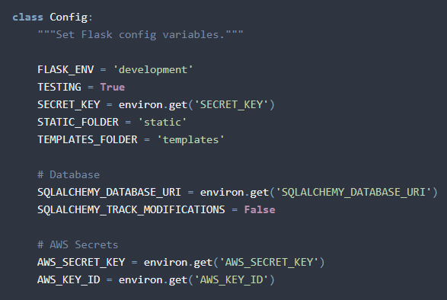
Testing Production Development
How to call from flask?
How to inherit ?

Slide 26
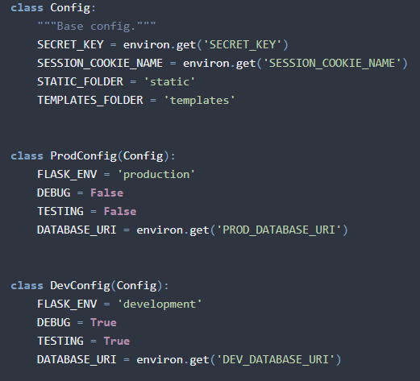
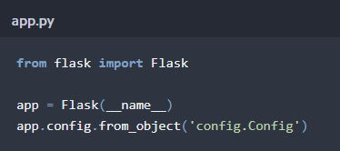
Solution
How to switch mode in Flask ?

Slide 27
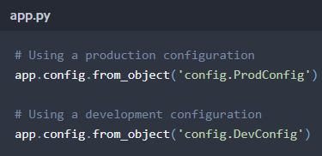
Solution

Slide 28

Import

Slide 29
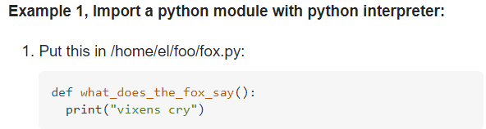
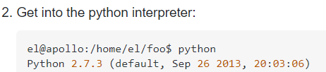
Importing in python
How to run the function?
Notes:
https://stackoverflow.com/questions/2349991/how-to-import-other-python-files
Just import file without the '.py' extension.
Styling of Import Statements
PEP 8, the official style guide for Python, has a few pointers when it comes to writing import statements. Here’s a summary:
Imports should always be written at the top of the file, after any module comments and docstrings.
Imports should be divided according to what is being imported. There are generally three groups:
standard library imports (Python’s built-in modules)
related third party imports (modules that are installed and do not belong to the current application)
local application imports (modules that belong to the current application)
Each group of imports should be separated by a blank space.

Slide 30
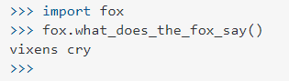
Solution

Slide 31
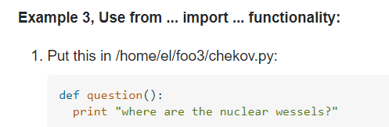
From .. Import ..
Notes:
Notice that I didn’t use question.question
If you defined other functions in chekov.py, they would not be available unless you import *

Slide 32
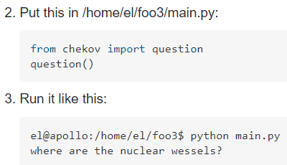
Solution
Notes:
Notice that I didn’t use question.question
If you defined other functions in chekov.py, they would not be available unless you import *

Slide 33
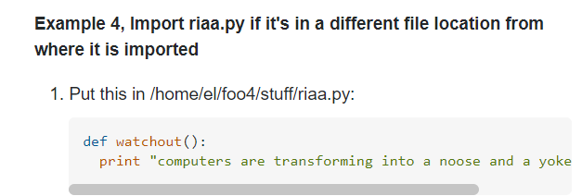
How to run from another directory ?

Slide 34
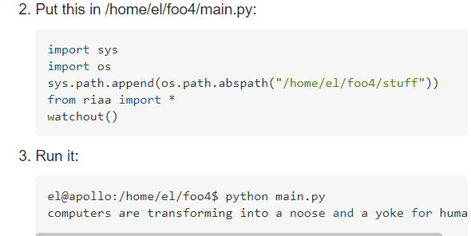
Solution
How to run from another directory ?

Slide 35
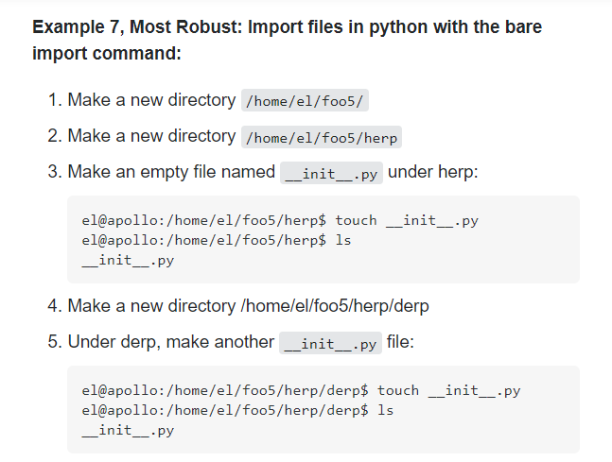
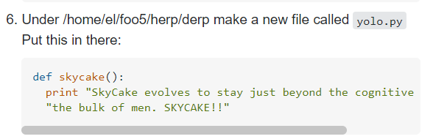
How to import skycake from foo5/main.py?
foo5
herp
init
derp
Main.py
Yolo.py
init

Slide 36
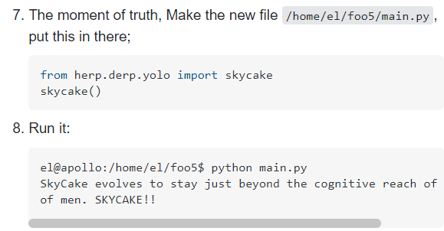
How to import skycake from foo5/main.py?
Notes:
The empty __init__.py file communicates to the python interpreter that the developer intends this directory to be an importable package.
This is in python2 not python3

Slide 37
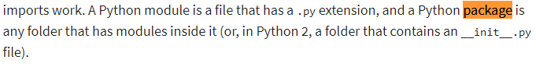
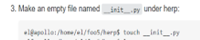
Package vs module
Do we still need this?

Slide 38
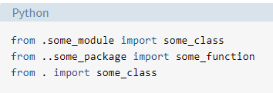
Where do we stand?
Dot
Two dots
Three dots
Notes:
https://realpython.com/absolute-vs-relative-python-imports/
A single dot means that the module or package referenced is in the same directory as the current location. Two dots mean that it is in the parent directory of the current location—that is, the directory above. Three dots mean that it is in the grandparent directory, and so on.
When u type import
The first thing Python will do is look up the name abc in sys.modules. This is a cache of all modules that have been previously imported.
If the name isn’t found in the module cache, Python will proceed to search through a list of built-in modules. These are modules that come pre-installed with Python and can be found in the Python Standard Library. If the name still isn’t found in the built-in modules, Python then searches for it in a list of directories defined by sys.path. This list usually includes the current directory, which is searched first.

Slide 39
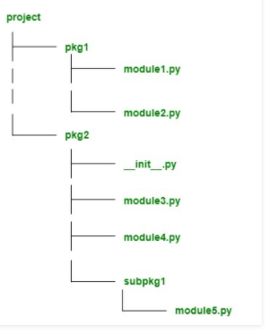
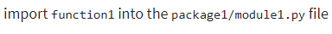
How to import?

Slide 40


Solution

Slide 41

How to import?

Slide 42


Solution
Notes:
In the first import statement, the single dot means that you are importing class1 from the current package. Remember that importing a package essentially imports the package’s __init__.py file as a module.
In the second import statement, you’d use a single dot again because subpackage1 is in the same directory as the current module, which is module3.py.

Slide 43



Minimalistic FLASK

Slide 44


Notes:
5 lines of code to start the application

Slide 45




Slide 46

Want to learn more?

Slide 47

FLASK-WTFORMS
FLASK
DJANGO
Notes:
Both Flask and Django have relied heavily on a single Python library by the name of WTForms. WTForms has strangely remained the undisputed library for handling forms for years without consequence: the library is easy to use, and nobody has maliciously hijacked the library to steal everybody's personal information or Bitcoin. That's the real difference between the Python and Javascript ecosystems.

Slide 48

APP? JINJA? FORMS ?
What’s their roles?
Notes:
APP controller checking URL and rendering the template with kwargs for forms and title
Jinja renders HTML with forms and titles embedded
Forms .. For form handling

Slide 49


Input
Notes:
Add here the more logical fields as string field

Slide 50


WTF

Slide 51


Validation

Slide 52

Contact form
Notes:
How

Slide 53


Slide 54

Notes:
StringField is a single-line text field, TextField is a multiline textarea, and so forth.

Slide 55

What gets rendered, success or the template?
Then why do we need jinja ?
Notes:
What gets rendered, success or the template
What is validate on submit?
Our contact route accepts both GET and POST requests; normally we handle routes like this by using a conditional on Flask's request object ( such as if request.method == 'POST' ), but we haven't even imported the request object at all! Because we used Flask-WTF's FlaskForm base class to create ContactForm(), we're able to simplify routes containing form logic into two scenarios: one where the user submitted a valid, and one for everything else. We're able to do this because our form now has a built-in method called validate_on_submit(), which detects if a request is both a POST request and a valid request. Remember, forms are either get or post
Why do we add get post as tuple not list ?
Providing a list of accepted methods is a good way to build constraints into the route for a REST API endpoint, which only makes sense in specific contexts.

Slide 56


Slide 57

What about throwing errors ?
What about having more than one error?
Notes:
Without error validation

Slide 58

Notes:
When a form in Flask fails, it executes the form action with metadata of the request provided. In our case, the action of our form reloads the page it lives on by default but sends along whichever form error messages were attached to the request. We can access form errors per field using form.email.errors, and since we know there might be multiple errors, we use {% for error in form.email.errors %} to loop through all errors for this single field.

Slide 59
Breakout
Create a sign up form with the fields
Email
Pass
Confirm pass
Title select from items
Website
Birthday
Recapthcha
Submit

Slide 60
Thank you!

